Slide 1

Look at the pictures and guess what you can see before your classmates!
Notes:
on various specific slides (e.g. competition, voc review) - put 1 page big, to show the main point (zoom?)
add page - extra resources - say it right, wonderful words, etc

Slide 2
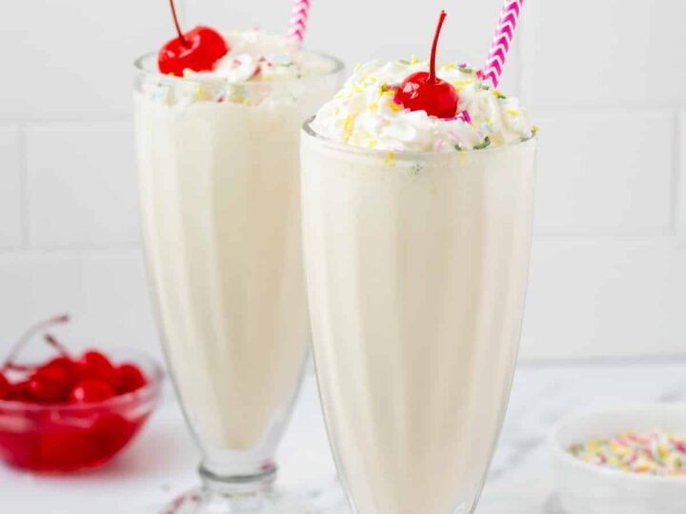
1
What can you see?
?
?
?
?
?
?
?
?
?

Slide 3
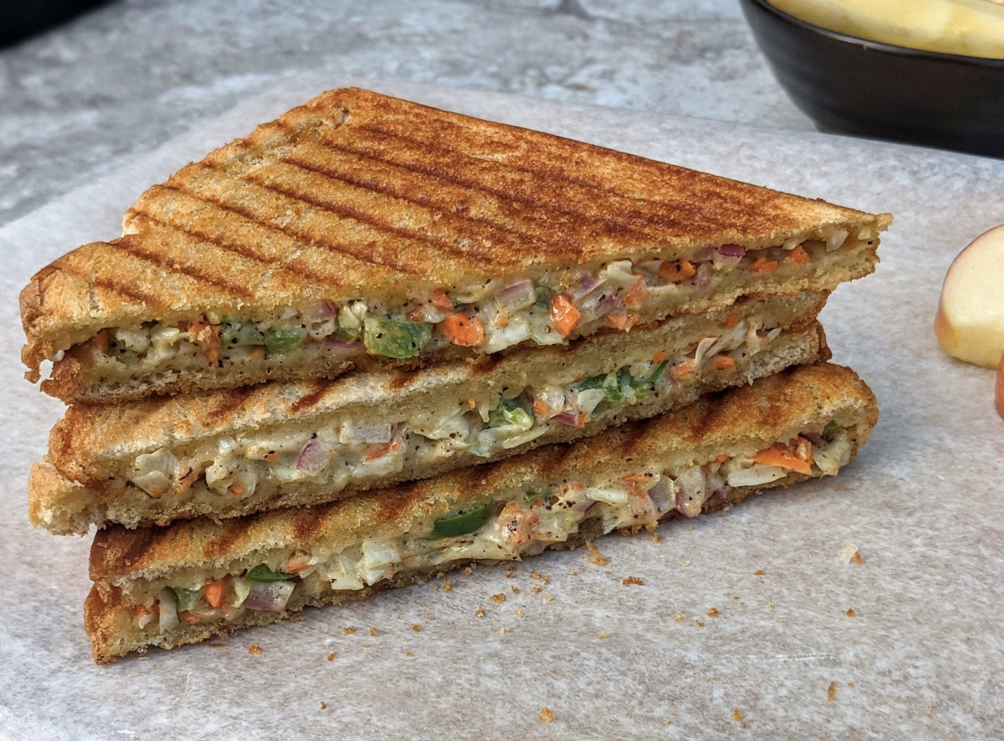
2
What can you see?
?
?
?
?
?
?
?
?
?

Slide 4

3
What’s her personality?
?
?
?
?
?
?
?
?
?

Slide 5
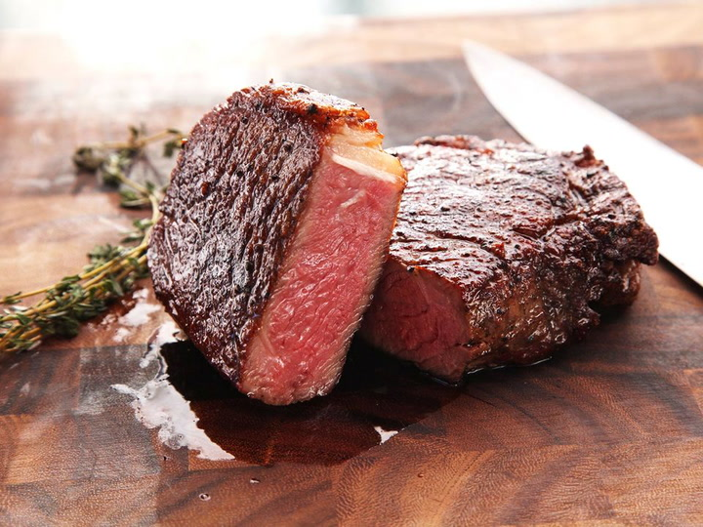
4
What can you see?
?
?
?
?
?
?
?
?
?

Slide 6
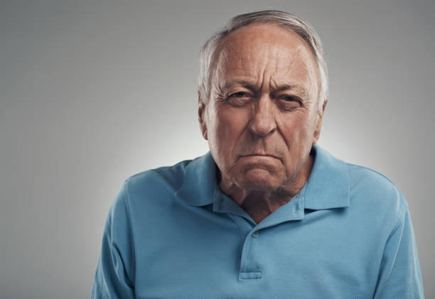
5
What’s his personality?
?
?
?
?
?
?
?
?
?

Slide 7
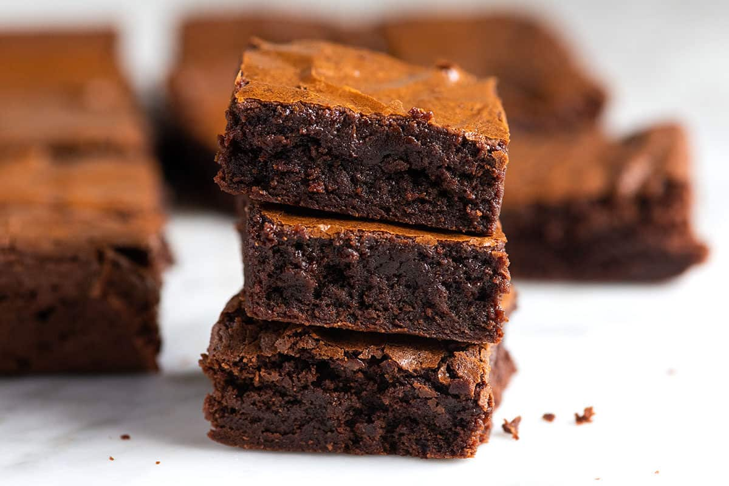
6
What can you see?
?
?
?
?
?
?
?
?
?

Slide 8
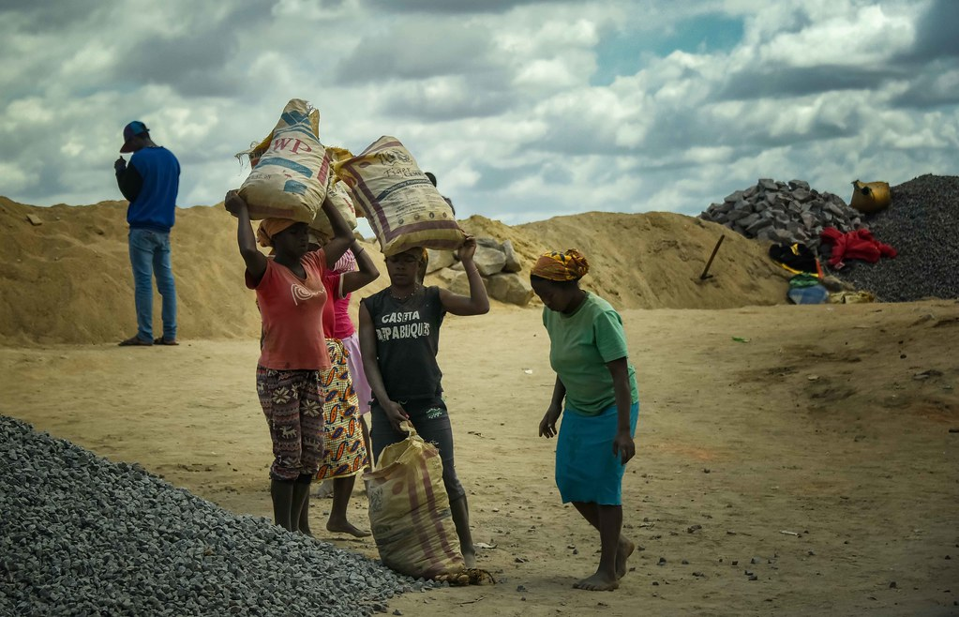
7
What’s their personality?
?
?
?
?
?
?
?
?
?

Slide 9

8
What can you see?
?
?
?
?
?
?
?
?
?

Slide 10
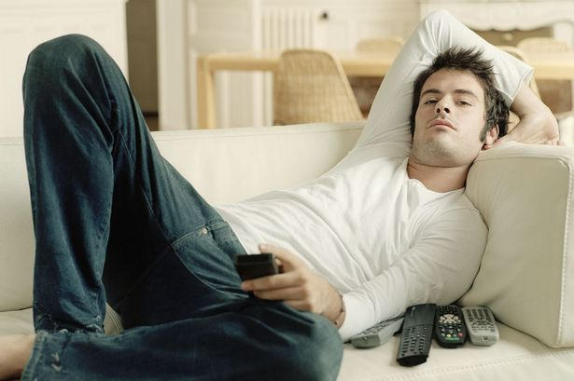
9
What’s his personality?
?
?
?
?
?
?
?
?
?

Slide 11
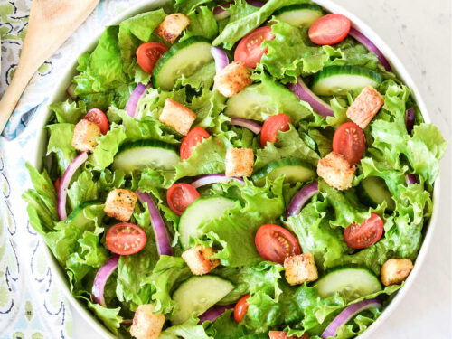
10
What can you see?
?
?
?
?
?
?
?
?
?

Slide 12
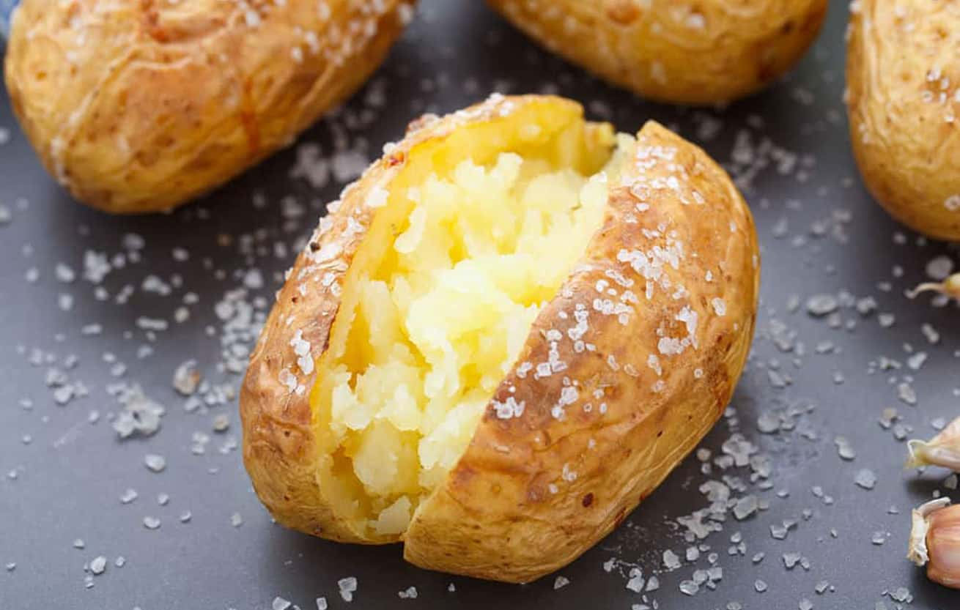
11
What can you see?
?
?
?
?
?
?
?
?
?

Slide 13

12
What’s her personality?
?
?
?
?
?
?
?
?
?

Slide 14
Answers
It’s a milkshake
It’s a grilled sandwich
She’s shy/timid
It’s a grilled steak
He’s grumpy/moody
They’re brownies
7. They’re hardworking
8. It’s a coffee
9. He’s lazy
10. It’s a salad
11. It’s a baked potato
12. She’s happy/cheerful

Slide 15

THANK YOU!
Well
done!
steppingstones.com.mx

